Slide 1

Photo Album
by Elias Paixão

Slide 2
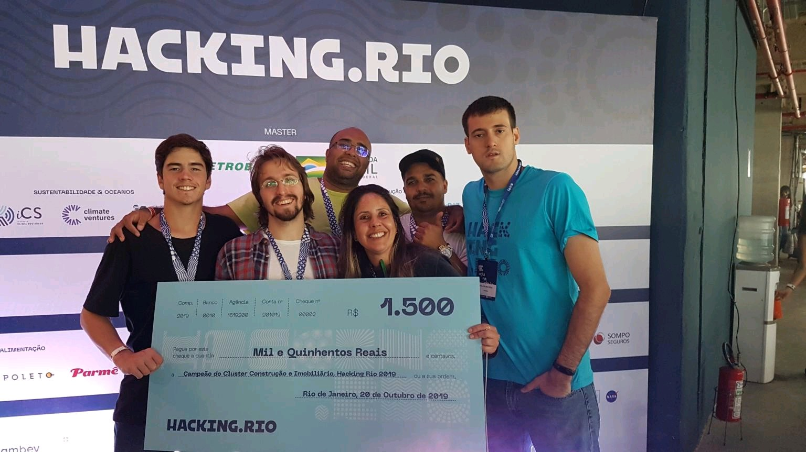

Slide 3
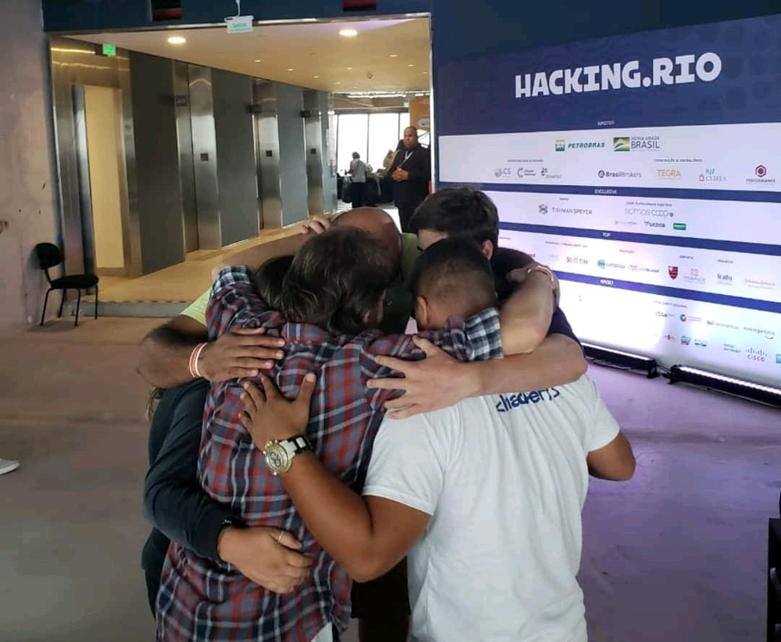

Slide 4


